Slide 1


Infosys SpringBoard Internship 4.0 (June – July 2024)
Image Captioning
MEDICAL IMAGES (X-RAYS)
Intern Name : Boddupally Sanjana
Mentor : Sudheer Kumar Y

Slide 2

Develop a deep learning model to generate accurate and meaningful captions for X-ray images, automating the interpretation process to enhance efficiency and consistency in medical image analysis.
PROBLEM
STATEMENT

Slide 3

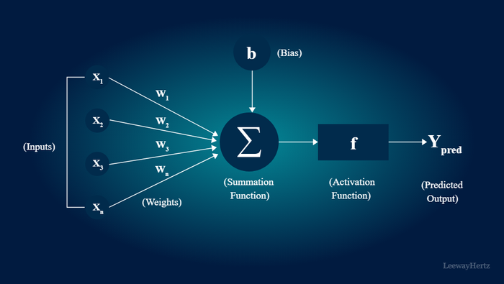
IMAGE CAPTIONING
Image Captioning is the process of automatically generating a textual description for an image using machine learning and computer vision techniques. This task involves understanding the content of the image, identifying key objects, actions, and scenes, and then expressing this understanding in natural language. Image captioning combines image processing and natural language processing, typically utilizing convolutional neural networks (CNNs) for extracting image features and recurrent neural networks (RNNs), like LSTMs, for generating coherent and contextually relevant sentences. The goal is to produce accurate, meaningful, and contextually appropriate descriptions that facilitate better understanding and communication of visual content.

Slide 4
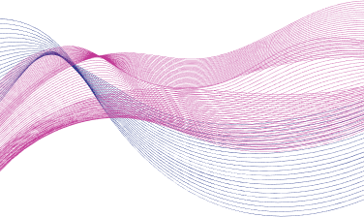
Medical Education
Helps medical students and trainees learn by providing detailed, consistent descriptions of images for study and reference.
USE CASES
Automated CCTV Monitoring
Image captioning can enhance CCTV systems by providing automated, realtime descriptions of captured scenes. This technology helps in identifying and reporting incidents .
Destination Image Captioning
Travel Guide AI leverages image captioning to provide detailed descriptions and highlights of travel destinations.

Slide 5

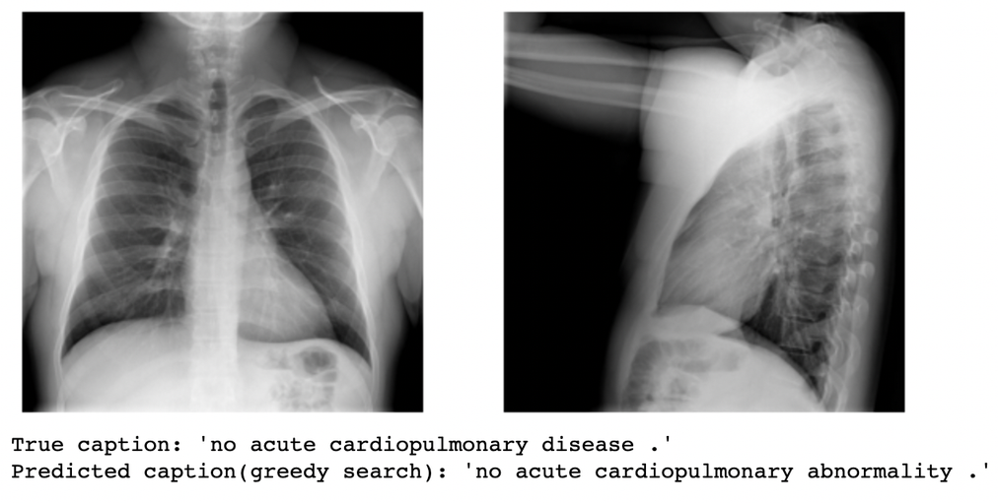
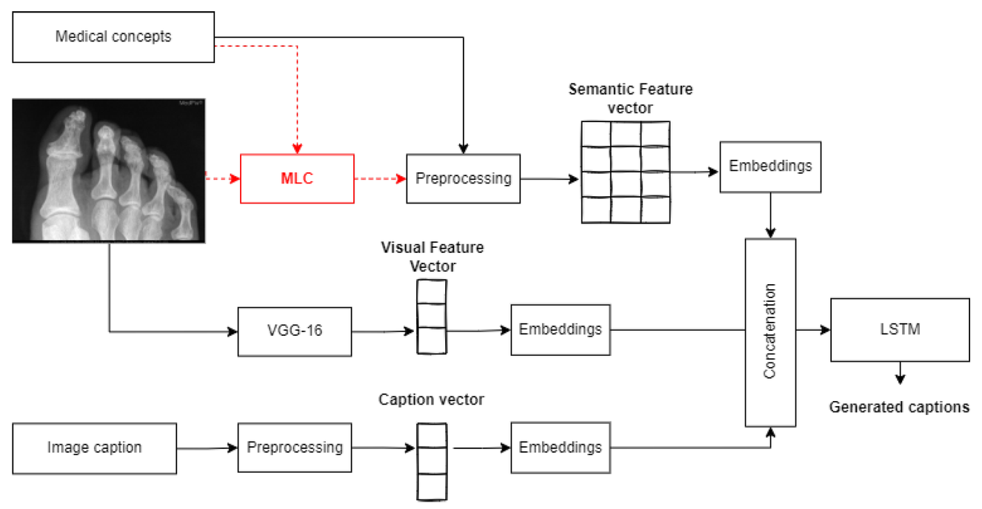
DATASET
The ROCO dataset is a Medical images dataset that provides Radiology & Non Radiology image-caption pairs essential for training and evaluating the image captioning model. This dataset encompasses a variety of images, each associated with descriptive captions.

Slide 6
MODEL ARCHITECTURE
Combines a Convolutional Neural Network (CNN) and a LSTM for image captioning.Utilizes InceptionV3 for image feature extraction and LSTM for sequence processing.
INPUT LAYERS
FEATURE EXTRACTOR (CNN)
SEQUENCE PROCESSOR (LSTM):
DECODER (COMBINING BOTH INPUTS)
MODEL COMPILATION
Image Input: Shape (224, 224, 3) for 224x224 pixel RGB images.
Caption Input: Shape determined by the maximum caption length.
The feature extractor (CNN) uses a pretrained InceptionV3 model with global average pooling to reduce spatial dimensions, keeping layers nontrainable to prevent overfitting. The output is then passed through a dense layer with 256 units and ReLU activation to produce the feature vector (fe2).
The model uses `categorical_crossentropy` as the loss function for multiclass classification, the `adam` optimizer for efficient training with an adaptive learning rate, and tracks accuracy as the performance metric during training and evaluation.
The embedding layer maps words to 256-dimensional vectors with mask_zero=True. A dropout layer with a 0.5 rate prevents overfitting, followed by an LSTM layer with 256 units for sequence processing.
The Add function combines CNN and LSTM outputs through elementwise addition. A dense layer with 256 units and ReLU activation (decoder2) is applied, followed by a final dense layer with softmax activation and vocab_size units to generate a probability distribution over the vocabulary.

Slide 7
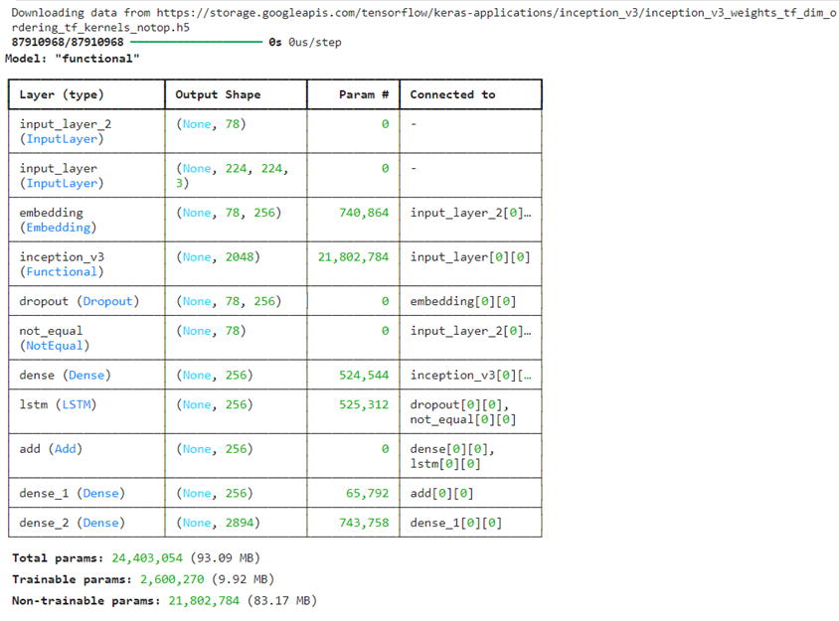
Model Summary

Slide 8
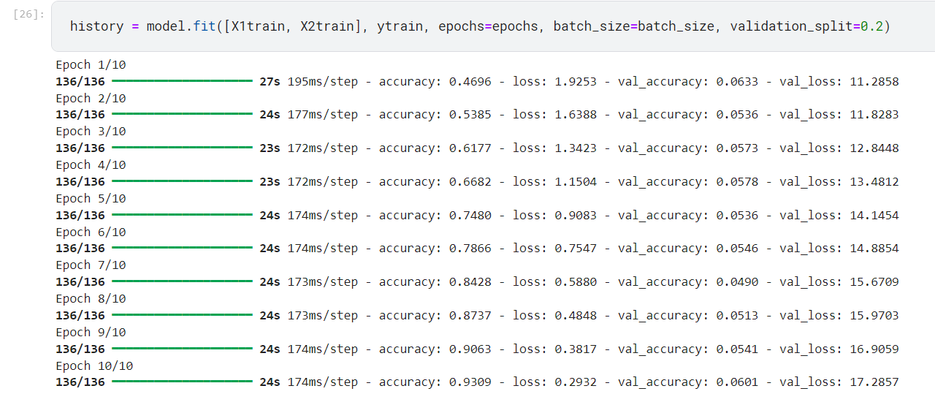
EPOCHS

Slide 9
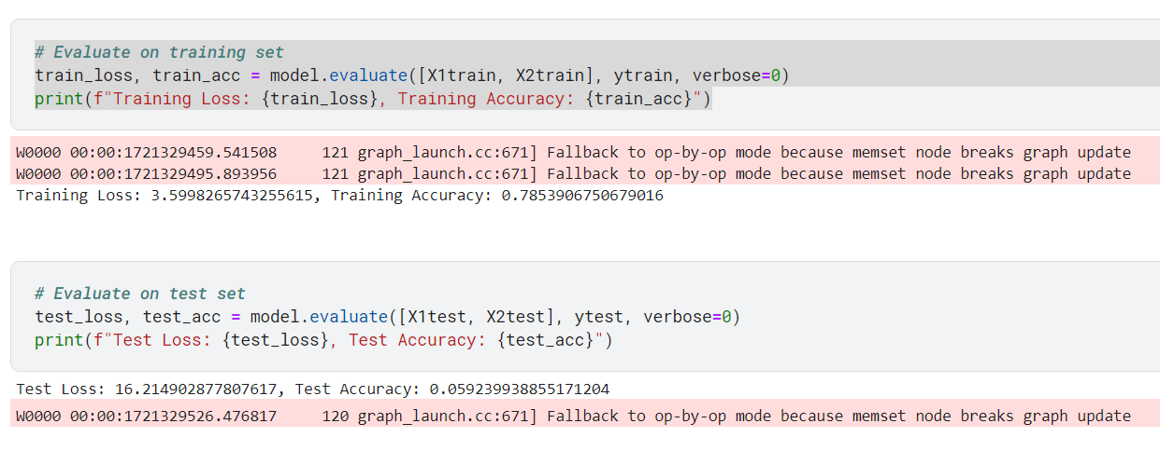
MODEL EVALUATION
Fig : Model Evaluation on Train & Test sets

Slide 10
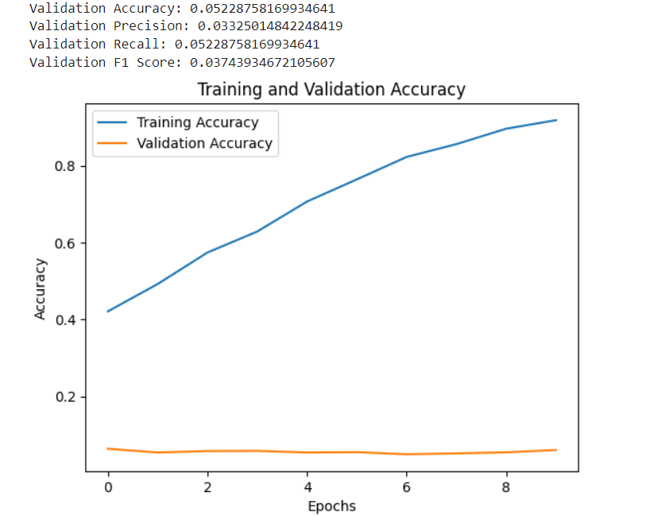
MODEL EVALUATION
Fig : Model Evaluation on Validation Set & Plot

Slide 11
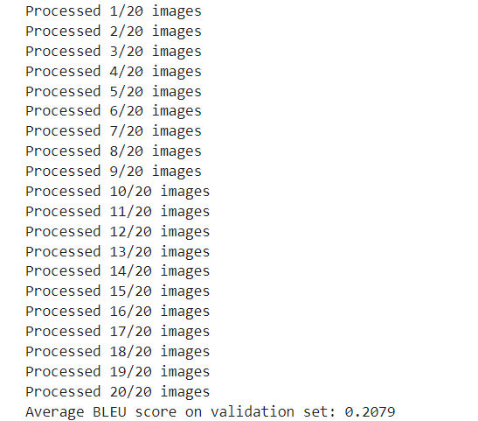
MODEL EVALUATION
Fig 4.8 : BLEU Score

Slide 12

CONCLUSION
The image captioning project demonstrated promising initial results, achieving a high training accuracy of 78.54%, which indicates the model's capability to learn and understand the training data effectively. Despite the challenges of overfitting and the need for better generalization to unseen data, the model's ability to generate meaningful captions is evident. The average BLEU score of 0.2079 on the validation set highlights its potential in generating reasonably aligned captions. With further refinements such as implementing regularization techniques, tuning hyperparameters, and enhancing the preprocessing pipeline, the model's performance can be significantly improved. These initial successes provide a strong foundation for continued development and optimization, ultimately leading to a robust image captioning system.

Slide 13
THANK YOU

